Slide 1
Java Generics
In Java
Author: Denis Kohanevich

Slide 2
Motivation
In any nontrivial software project, bugs are simply a fact of life. Careful planning, programming, and testing can help reduce their pervasiveness, but somehow, somewhere, they'll always find a way to creep into your code. This becomes especially apparent as new features are introduced and your code base grows in size and complexity.
Compile-time bugs can be detected early on, you can use the compiler's error messages to figure out what the problem is and fix it, right then and there.
Generics add stability to your code by making more of your bugs detectable at compile time.

Slide 3
Why Use Generics?
Code that uses generics has many benefits over non-generic code:
Stronger type checks at compile time.
A Java compiler applies strong type checking to generic code and issues errors if the code violates type safety. Fixing compile-time errors is easier than fixing runtime errors, which can be difficult to find.
Elimination of casts.

Slide 4
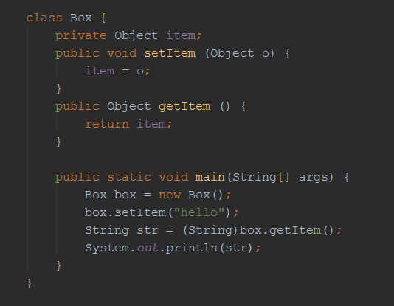
Before Java 1.5

Slide 5
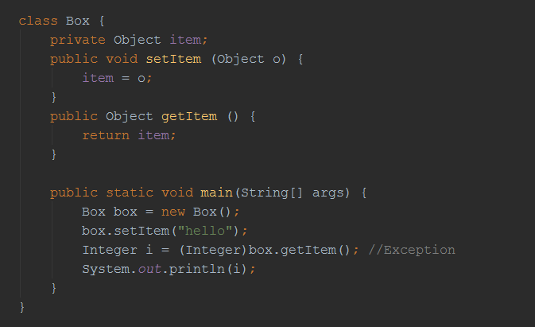
Potential problems

Slide 6
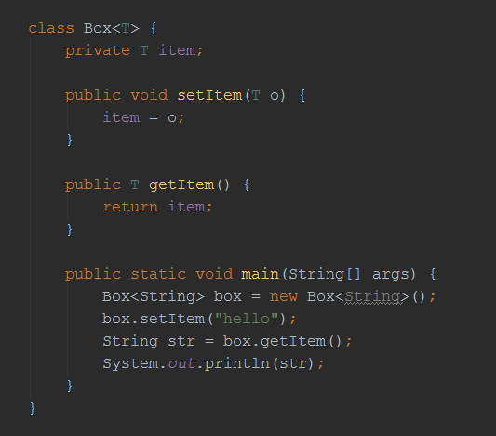
Using Generics

Slide 7
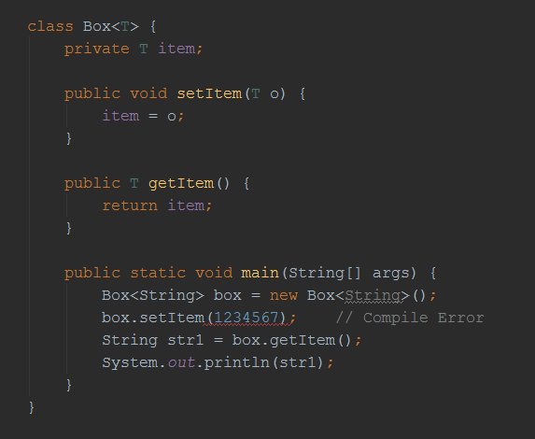
Using Generics

Slide 8
Generic Types & Naming Convention
A generic class is defined with the following format:
class Name<T1, T2, ..., Tn> { /* ... */ }
The most commonly used type parameter names are:
  E - Element (used extensively by the Java Collections Framework)
  K - Key
  N - Number
  T - Type
  V - Value
  S,U,V etc. - 2nd, 3rd, 4th types

Slide 9
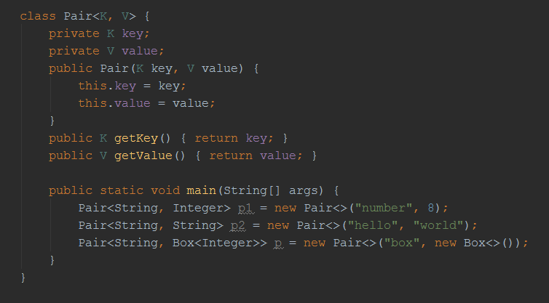
Generics example

Slide 10
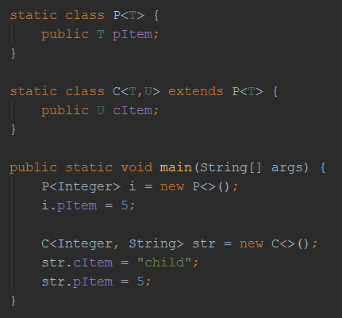
Generics example

Slide 11
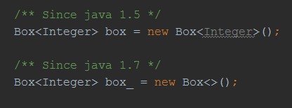
The Diamond

Slide 12
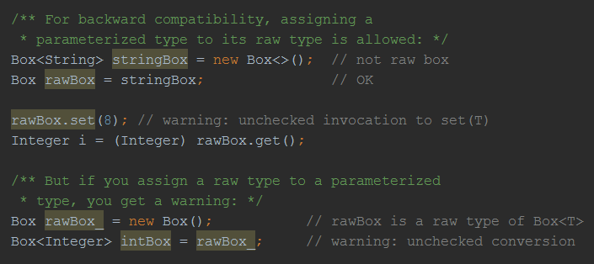
Raw Types

Slide 13
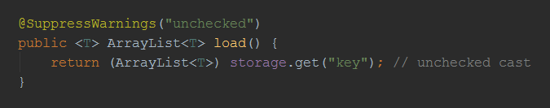
Suppress Warnings

Slide 14
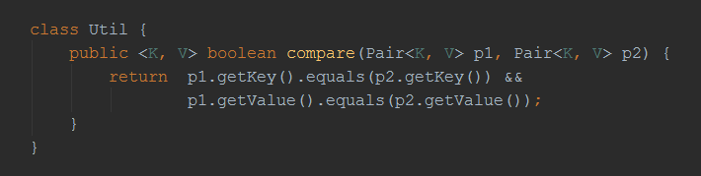
Generic Methods

Slide 15
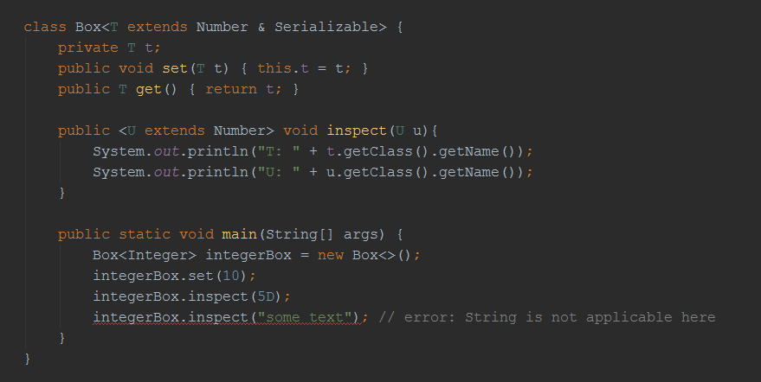
Bounded Type Parameters

Slide 16
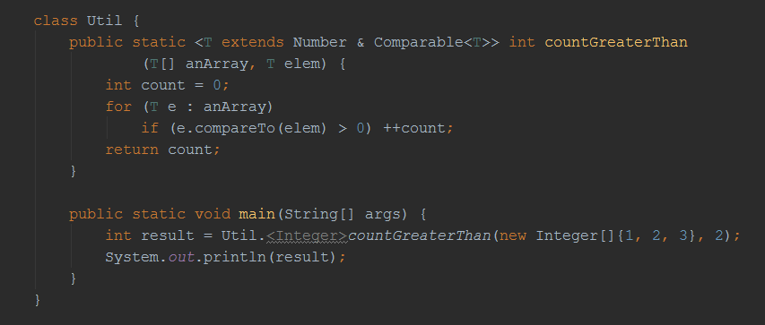
Generic example

Slide 17
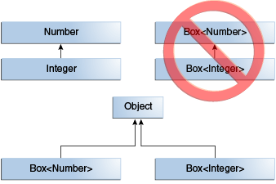
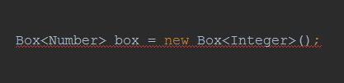
Generics, Inheritance, and Subtypes

Slide 18
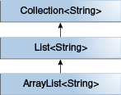
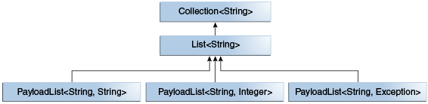
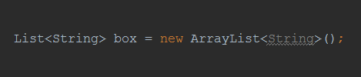
Generic Classes and Subtyping

Slide 19
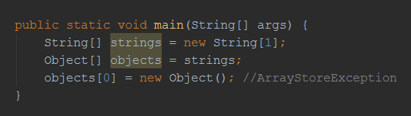
Arrays inheritance problem

Slide 20
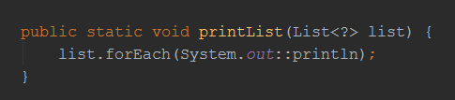
Wildcards. Unbounded Wildcards

Slide 21
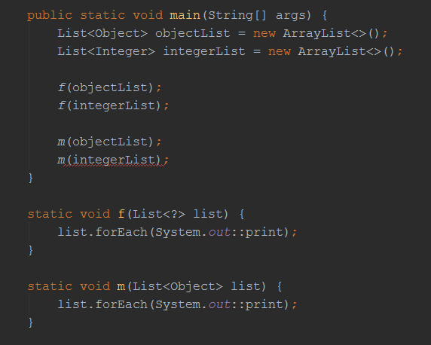
Wildcard vs Object

Slide 22
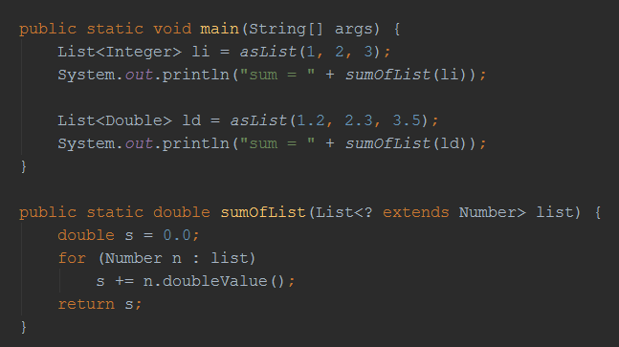
Upper Bounded Wildcards

Slide 23
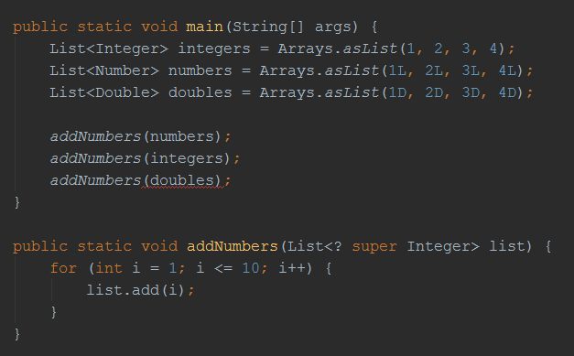
Lower Bounded Wildcards

Slide 24
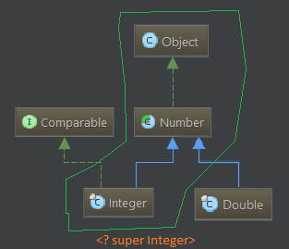
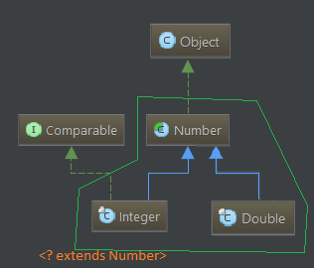
<? super Type> vs <? extends Type>

Slide 25
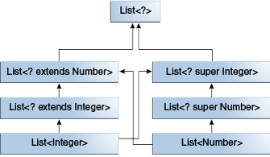
Wildcards and Subtyping

Slide 26
Guidelines for Wildcard Use
One of the more confusing aspects when learning to program with generics is determining when to use an upper bounded wildcard and when to use a lower bounded wildcard.
It is helpful to think of variables as providing one of two functions:
An "In" Variable
An "in" variable serves up data to the code. Imagine a copy method with two arguments: copy(src, dest). The src argument provides the data to be copied, so it is the "in" parameter.
An "Out" Variable
An "out" variable holds data for use elsewhere. In the copy example,
copy(src, dest), the dest argument accepts data, so it is the "out" parameter.

Slide 27
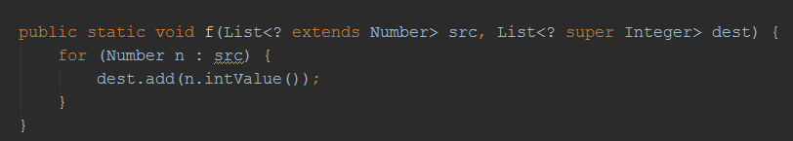
Generics example. PESC

Slide 28
Wildcard Guidelines:
An "in" variable is defined with an upper bounded wildcard, using the extends keyword.
An "out" variable is defined with a lower bounded wildcard, using the super keyword.
In the case where the "in" variable can be accessed using methods defined in the Object class, use an unbounded wildcard.
In the case where the code needs to access the variable as both an "in" and an "out" variable, do not use a wildcard.
Do not apply to a method's return type. Using a wildcard as a return type should be avoided because it forces programmers using the code to deal with wildcards.

Slide 29
Type Erasure
Generics were introduced to the Java language to provide tighter type checks at compile time and to support generic programming. To implement generics, the Java compiler applies type erasure to:
Replace all type parameters in generic types with their bounds or Object if the type parameters are unbounded. The produced bytecode, therefore, contains only ordinary classes, interfaces, and methods.
Insert type casts if necessary to preserve type safety.
Generate bridge methods to preserve polymorphism in extended generic types.
Type erasure ensures that no new classes are created for parameterized types; consequently, generics incur no runtime overhead.

Slide 30
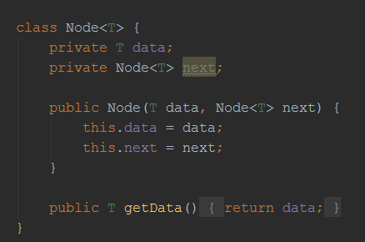
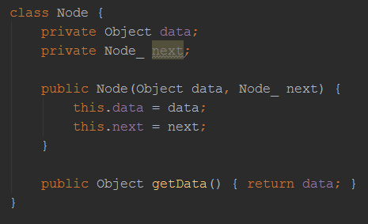
Type Erasure example

Slide 31
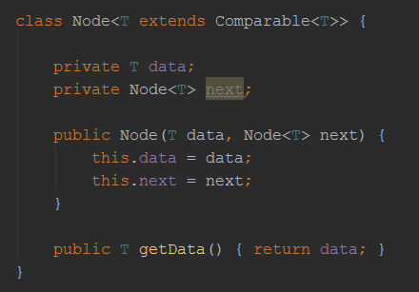
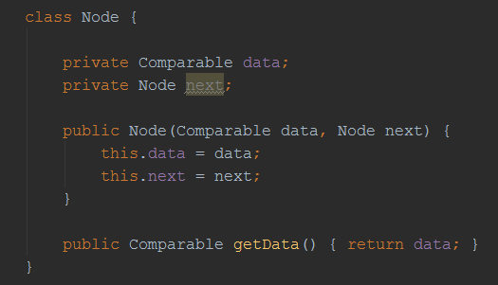
Type Erasure example

Slide 32
Restrictions on Generics
To use Java generics effectively, you must consider the following restrictions:
Cannot Instantiate Generic Types with Primitive Types
Cannot Create Instances of Type Parameters
Cannot Declare Static Fields Whose Types are Type Parameters
Cannot Use Casts or instanceof With Parameterized Types
Cannot Create Arrays of Parameterized Types
Cannot Create, Catch, or Throw Objects of Parameterized Types
Cannot Overload a Method Where the Formal Parameter Types of Each Overload Erase to the Same Raw Type

Slide 33
Thanks!
Q & A

